Slide 1
Lending Club Case Study

Slide 2
Table of contents
General information about case study
Factors affecting loan default rate
Technologies used
Acknowledgements

Slide 3
General information
Lending club case study is analysis of various factors on loan repayment. The insights of this analysis will help banks to identify if a person is likely to replay loan or not.
The idea behind implementing this project is to understand how real business problems are solved using EDA. Apart from applying EDA techniques, we also learnt about risk analytics in banking and financial services.
Lending loans to ‘risky’ applicants is the largest source of financial loss (called credit loss). Credit loss is the amount of money lost by the lender when the borrower refuses to pay or runs away with the money owed. In other words, borrowers who default cause the largest amount of loss to the lenders. In this case, the customers labelled as 'charged-off' are the 'defaulters'. If one is able to identify these risky loan applicants, then such loans can be reduced thereby cutting down the amount of credit loss. Identification of such applicants using EDA is the aim of this case study.
Loan data set contains the complete loan data for all loans issued through the time period 2007 to 2011.

Slide 4
Driving factors for loan default rate
Below are the driving factors which affect the default rate. We will discuss each one them one by one.
Annual income
Home ownership
Loan term
Debt to income ratio
Loan purpose
Interest rate

Slide 5
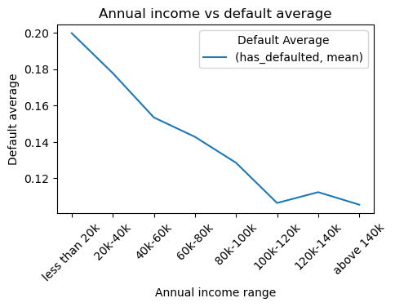
Affect of annual income on loan default rate
For studying the impact of annual income on loan default rate, we removed incomes which were not made by most people from the data set so that our analysis do not get skewed.
Incomes were clubbed into ranges of 20k i.e. ‘20k-40k’, ‘40k-60k’ and so on.
Defaulters were grouped by income ranges and following trend was observed .
Conclusion : The loan default rate goes down with increase in income.
Recommendation: This analysis suggest that it is safe to give loans to people with decent annual income than people with low income.

Slide 6
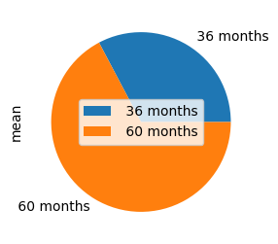
Affect of loan term on default rate
To study the impact of type of loan term i.e. 36 or 60 months, on default rate we grouped defaulters by loan term and plotted a pie chart shown alongside.
Conclusion: The chart suggests that people who take loan for longer period default more than people who take loan for short period.
Recommendation: It is safe to give loan for short period than for long period.

Slide 7
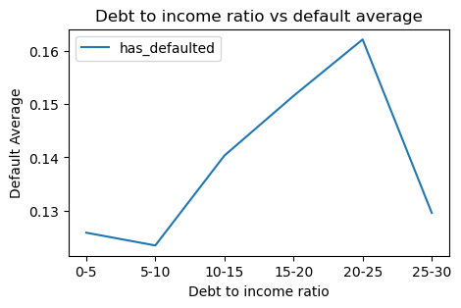
Affect of debt to income ratio on loan default rate
People in loan dataset were having debt to income ratio between 0 to 30. We made 6 ranges of debt to income ratio i.e 0-5, 5-10, 10-15, 15-20, 20-25, 25-30 and we categorized each person in dataset by range of debt to income ratio they fall in.
On grouping defaulters by debt to income ratio ranges we get observation as shown alongside.
Conclusion: Default rate increases with increase in debt to income ratio until 20-25 range than drops for 25-30 range.
Recommendation: It is safe to give loans to people with low debt to income ratio.

Slide 8
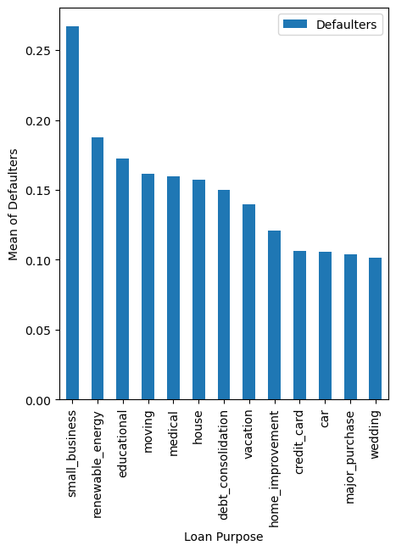
Affect of loan purpose on default rate
We grouped default rate by the purpose of loan and found results as shown alongside.
Conclusions: Loan taken for the purpose of small business has the highest default rate and loan taken for the wedding has the lowest default rate.
Recommendations: It is very risky to give loan to fund small businesses.

Slide 9
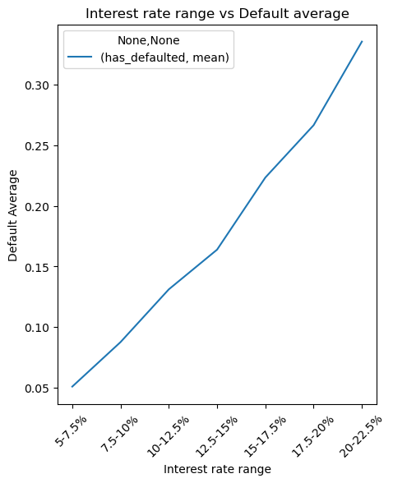
Affect of interest rate on loan default rate
To study affect of interest rate on loan default rate we divided interest rate into ranges i.e. 5-7.5%, 7.5-10%, 10-12.5% and so on. Then we grouped defaulters by interest range and plotted line graph shown alongside.
Conclusion: The default rate is proportional to rate of interest.
Recommendation: It is safe to provide loans on lower rate of interest than on higher rate of interest.

Slide 10
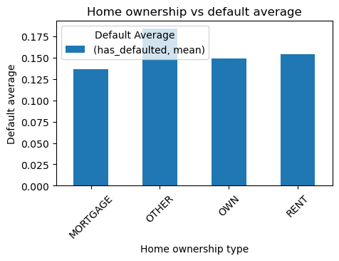
Affect of home ownership on default rate
To study affect of home ownership i.e. own house, rented house, mortgaged house on loan default rate we removed home ownership ‘NONE’ from dataset because it seems that homeownership information was not available with banks for those records and then we grouped defaulters by home ownership and plotted a bar graph as shown along side.
Conclusion: There is no clear correlation between home ownership and default rate.
Recommendation: Homeownership status has no significant affect on default rate so it should not be considered as an important factor while lending out loans.

Slide 11
Technologies used
Python
Numpy
Pandas
Matplotlib
Seaborn

Slide 12
Acknowledgement
Sincere thanks to Upgrad/IIITB teachers, buddies for very clear and informative sessions and resolving our doubts everyday.
Entire Upgrad team for bringing to us such an awesome learning platform.

Slide 13
Thank you

